Slide 1
FY BTech BEEE Lab Expt No. 8 Based on Unit 6 : AC circuits
R L C Series Resonant Circuit

Slide 2
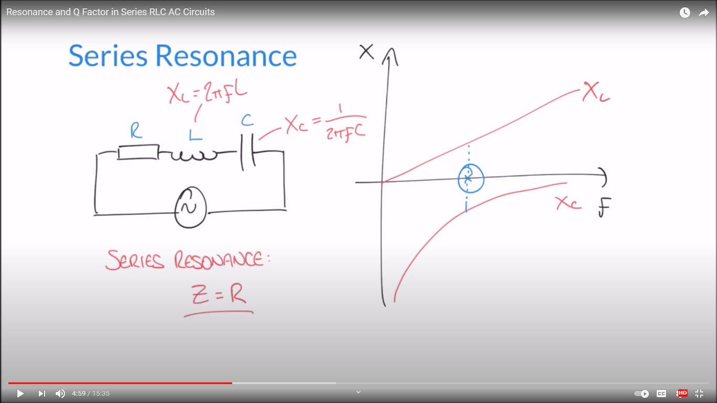
Inductive reactance Vs frequency Capacitive reactance Vs frequency

Slide 3
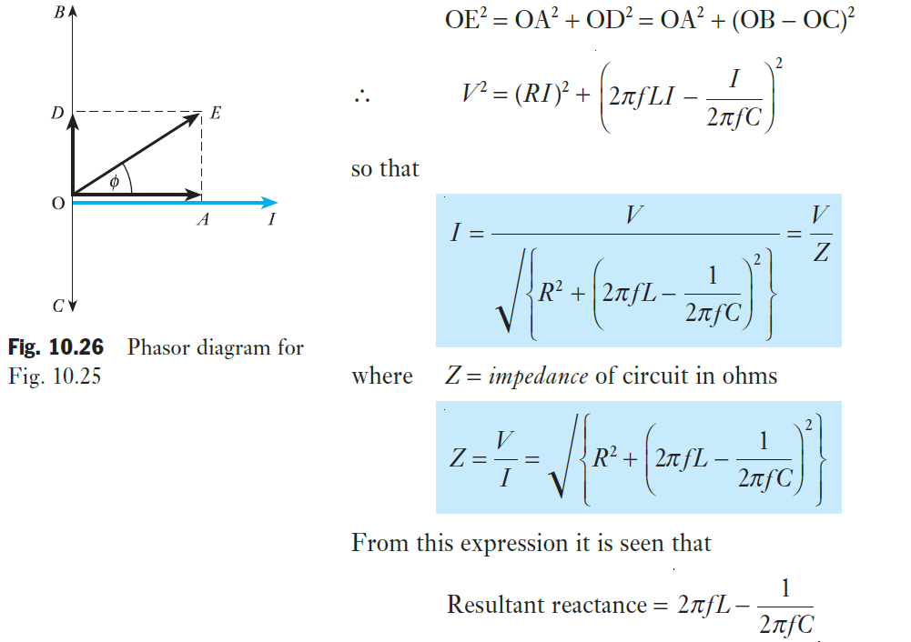
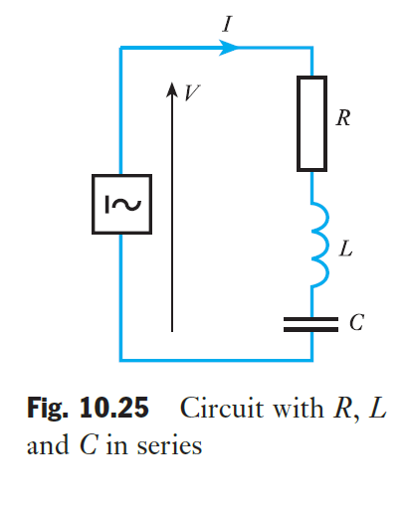
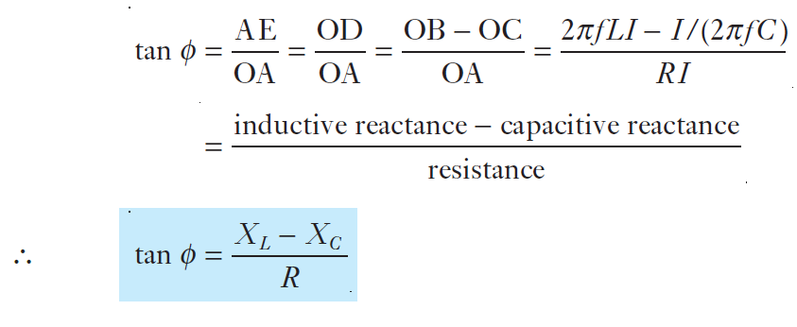
Alternating current in an RLC circuit
= inductive reactance − capacitive reactance

Slide 4
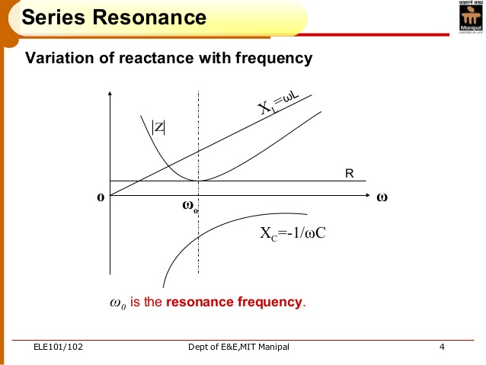

Slide 5
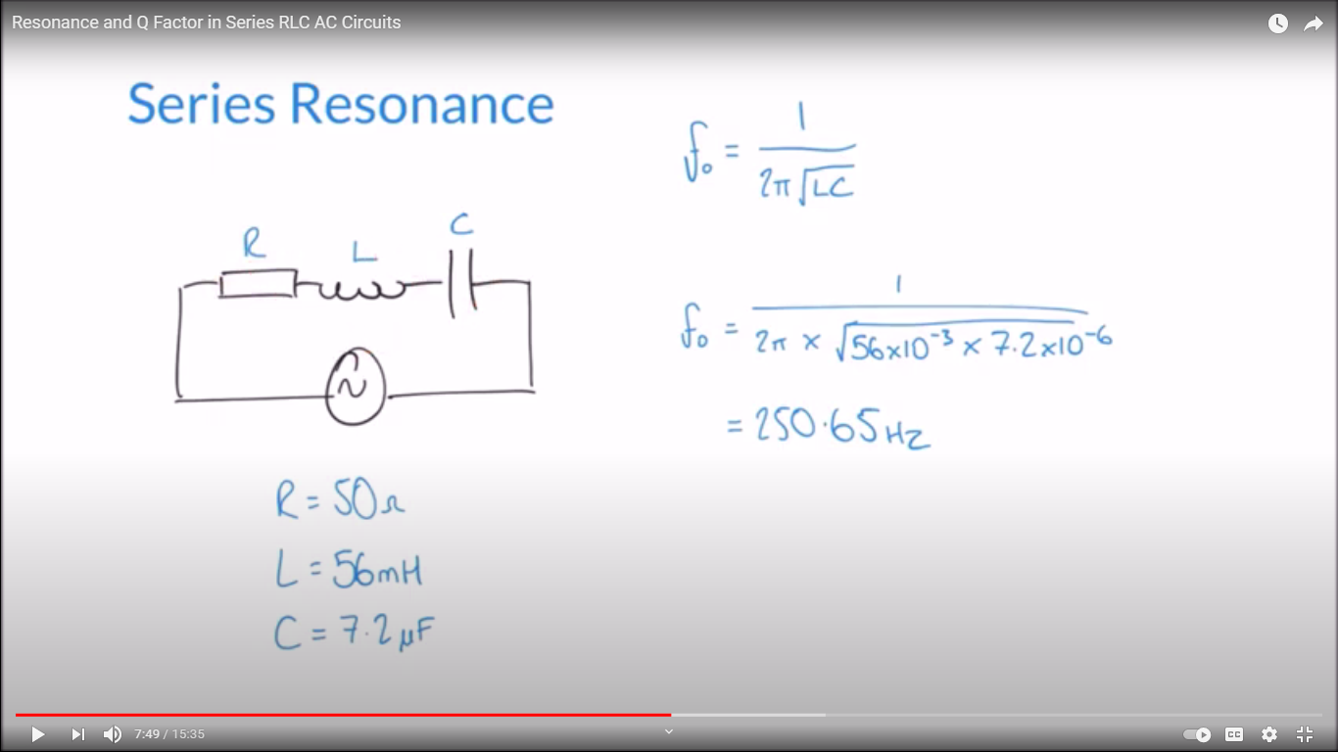
Calculation of resonant frequency

Slide 6
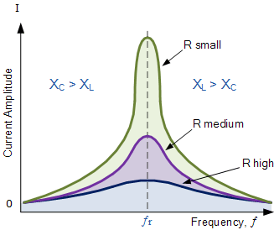
Resonance Curves

Slide 7
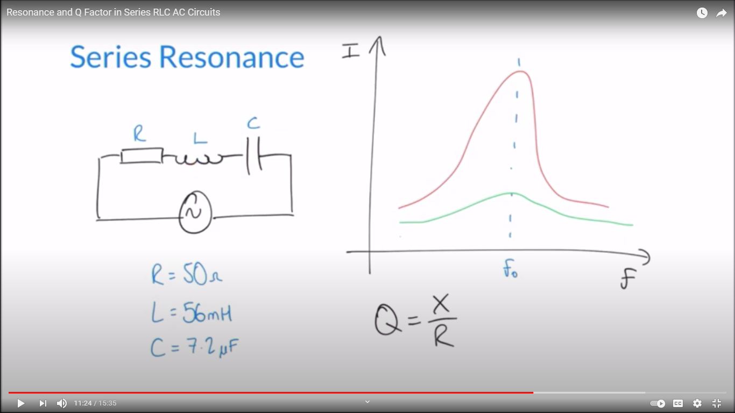
Q Factor

Slide 8
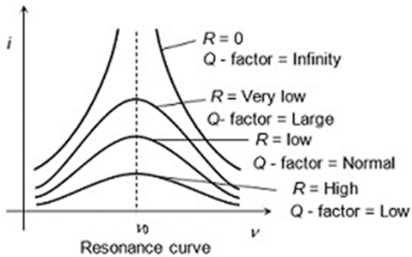
Q Factor

Slide 9
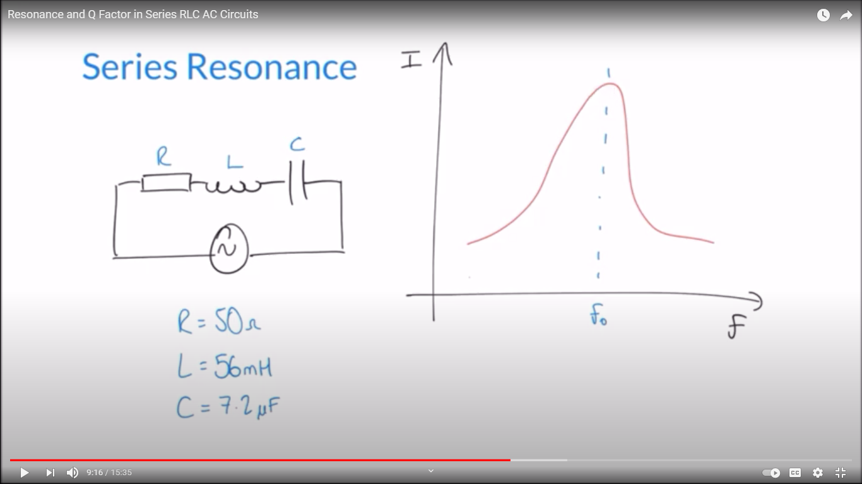
Resonance Curve

Slide 10
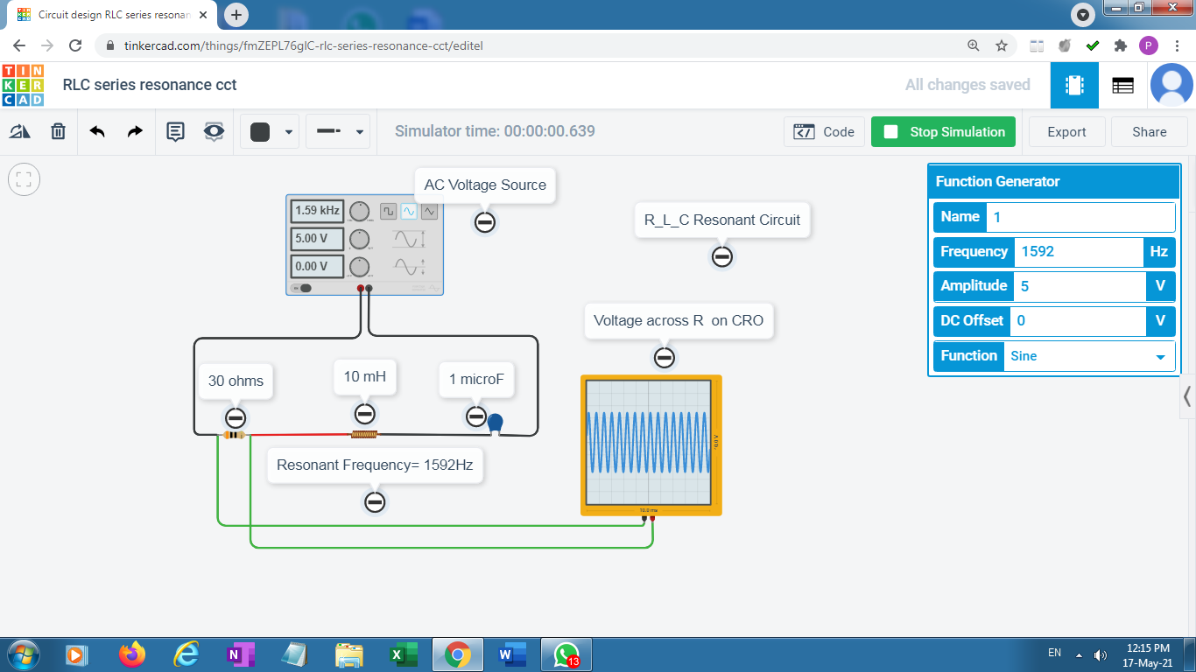

Slide 11
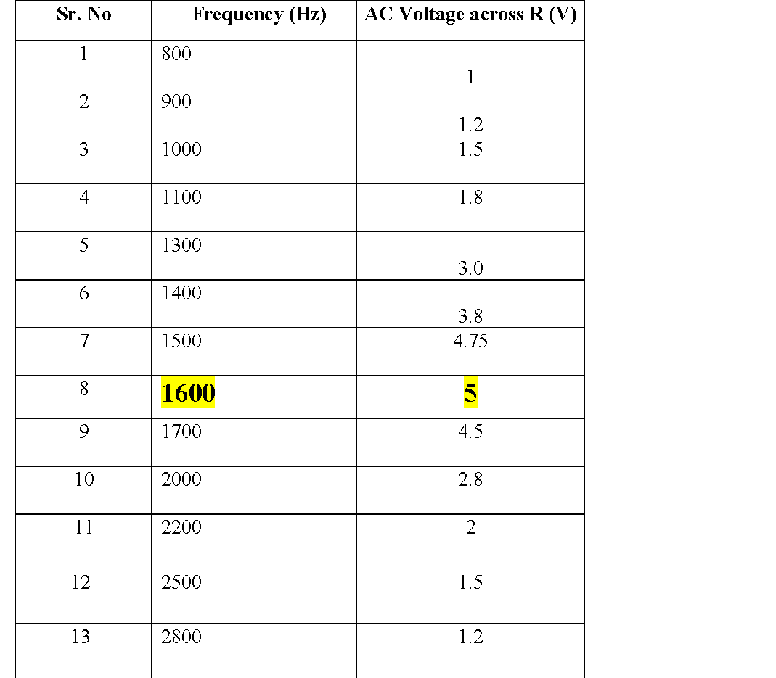
Observation Table

